Slide 1
Concussion in the Classroom
Jason M Matuszak, MD, FAAFP
Chief of Sports Medicine
Excelsior Orthopaedics

Slide 3
Heightened Awareness
New York State Law - S 3953 (2011)
…The legislation also requires the immediate removal of any student who has or who may have suffered a concussion. No student who has or who may have suffered a concussion may return to athletic activities unless the student has been symptom free for at least twenty-four hour and a licensed physician has authorized the student's return.
National Federation of High Schools (NFHS)
Governing body for sports (rules, officiating, etc.)
Officials may now remove athletes from play
Multiple high profile injuries over recent years
Lawsuits

Slide 4
What is a Concussion?
A complex pathophysiological process affecting the brain, induced by traumatic biomechanical forces
Direct or Indirect
Impairment of neurologic function that resolves spontaneously
Neuropathologic changes
Functional rather than structural
May not involve Loss of Consciousness
No radiologic Abnormalities on standard imaging
McCrory, 3rd international Concusion in Sport, Zurich, Clin J Sport Med 2009
Notes:
3rd international consensus statement: Vienna, Prague, Zurich
IOC, FIFA, International Ice Hockey Federation
Concussion may be caused either by a direct blow to the head, face, neck, or elsewhere on the body with an “impulsive” force transmitted to the head
Concussion typically results in the rapid onset of short-lived impairment of neurologic function that resolves spontaneously
Concussion may result in neuropathologic changes, but the acute clinical symptoms largely reflect a functional disturbance rather than a structural injury.
Concussion results in a graded set of clinical symptoms that may or may not involve loss of consciousness. Resolution of the clinical and cognitive symptoms typically follows a sequential course; however, it is important to note that, in a small percentage of cases, post-concussive symptoms may be prolonged.
No abnormality on standard structural neuroimaging studies is seen in concussion.

Slide 5
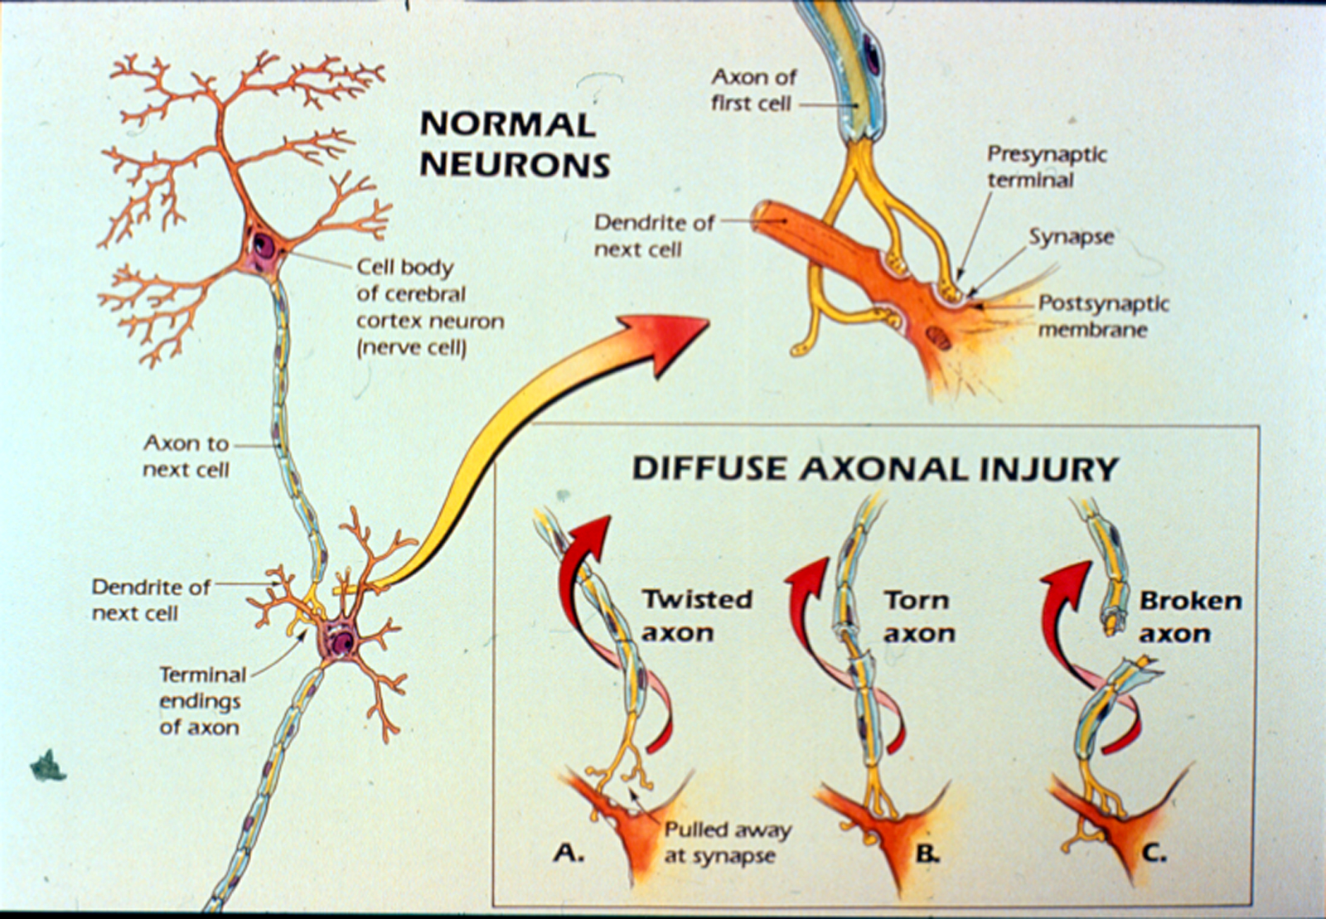

Slide 6
Concussion
1.6-3.8 million concussions annually in young people
Average of 7-10 days to resolve
Adolescents and children can normally take up to 28 days
Some have problems for months….
Impairs ability to function in everyday life and activities, including school based activities
May look physically normal

Slide 7
Causes of TBI
MVA
Other
Sports
Assaults

Slide 8
Why is concussion a big problem for those affected?
Memory and learning difficulties
Decreases in attention, processing speed, and problem solving abilities
Weaker planning ability and impaired future memory
Sleep disturbance, fatigue, headaches, fogginess, and somatic complaints
Decreased ability to cope with stress, increased irritability

Slide 9
MEMORY COMPOSITE Control vs. Concussed Athletes
Significant
difference between
groups out to
at least 8 days
post-injury
N.S.
p.<.00001
p.<.0001
p.<.03
N=410
.
*Lower score indicates poorer performance
Collins MW, Lovell MR, Maroon et al. Medicine and Science in Sports Exercise, 34:5;2002

Slide 10
REACTION TIME COMPOSITE Control vs. Concussed Athletes
Significant difference between groups out to 5 days post-injury
N=410
N.S.
p.<.005
p.<.0004
N.S.
.
*Higher score indicates poorer performance
Lovell MR, Collins MW, Maroon et al. Medicine and Science
in Sports Exercise, 34:5;2002

Slide 11
Recovery

Slide 12
Assess the Concussed Athlete: Immediate and Delayed Symptoms
Notes:
There are likely differences between symptom frequency experienced by gender and age.
There may also be a significant bias associated with how diagnosis of concussion is made. i.e. is headache the most common symptom of concussion, or does the presence of headache prompt the diagnosis?

Slide 13
Headache
Implications
Adjustments
Most common symptom
Distracting
Variable throughout day
Trigger
Noise
Light
Concentration
Frequent breaks
Identify triggers and reduce exposure
Rests/Naps in Nurse’s office/quiet area

Slide 14
Dizziness
Implications
Adjustments
Indication of vestibular system injury
Typically last longer
Positional changes
Provoked by
visual stimulus, especially videos
moving targets
Allow to put head down
Leave class early for classroom changes

Slide 15
Visual Symptoms (Light sensitivity, double or blurry vision)
Implications
Adjustments
Difficult to manage with high visual demands in classroom
Artificial lighting
Difficulty reading and copying
Computers
Smart Boards
iPads
Slide presentations
Reduce screen brightness
Allow hat or sunglasses
Consider use of audiotapes
Turn off fluorescent lights
Seat student closer to center/front

Slide 16
Noise Sensitivity
Implications
Adjustments
Lunchroom
Some classes
Music, Shop, Phys Ed
Crowded hallways
Organized sports activities
Social school activities
Pep rallies, school dances, loud sporting events
Allow lunch in quiet area with classmate
Limit or avoid loud class time
Consider ear plugs
Early class dismissal to avoid crowded hallways

Slide 17
Difficulty Concentrating or Remembering
Implications
Adjustments
Learning new tasks
Comprehending new material
Reccalling and applying previously learned material
Lack of focus
Trouble with test taking
Troubles with standardized tests
Difficulty reading
Trouble with distractions (driving)
Avoid testing or major projects when possible
Provide extra time for nonstandardized tests
Postpose standardized tests (may require 504)
Consider 1 exam per day
Consider pre-printed notes or scribe
Consider oral reader for test-taking

Slide 18
Sleep Disturbances
Implications
Adjustments
Excessive fatigue
Hamper memory and focus
Excessive napping may lead to further disruptions of sleep-wake cycle
Consider shorter school days
Allow rest breaks
Quiet meditation vs naps

Slide 19
Reentry to School
Identification – consider using liaison (nurse, psychologist, teacher) to coordinate
Accommodate gradual increase in cognitive and physical activity
Allow rest periods as needed
Increase time allowed for tests/assignments
Manageable pieces

Slide 20
Return to Learn
Very symptomatic students will often be held out of school
Unable to perform work of even up to 30 minutes
Half days
Usually when student can tolerate 30-45 minutes of work at a time
Consider alternating first and second halfs
Consider full days, but attending alternating classes

Slide 21
Academic Accomodations
Academic “adjustments”
Typically 1-3 weeks during recovery phase
Do not jeopardize the curriculum
Do not require alterations in standardized testing
Academic Accommodations
Typically longer than 3-4 weeks
Consider team evaluation
Evaluation process for 504 plan or IEP
Involvement of TBI specialist

Slide 22
Individualized education plan (IEP)
Formalized educational plan protected under the Individuals with Disabilities Education Act (special education), that provides for classification or coding of a student under 1 of 13 federally designated categories and allowances for modification of regular education without penalty to the student.

Slide 23
504 Plan
Section 504 of the Rehabilitation Act and the Americans with Disabilities Act provides for a student who is not eligible for special education under an IEP but who requires accommodations in regular education on the basis of bona fide medical need, as documented by a physician and validation by the educational home.

Slide 24
Why are some kids more adversely affected?
Neural Reserve
Younger may be more affected
High achievers
ADD/ADHD or Learning disabilities
Migraine sufferers or family history
Mood disorders, new or pre-existing
Pre-injury alcohol consumption or marijuana/drug use

Slide 25
Consensus Guidelines on Sport Related Concussion
Concussed athletes must be evaluated and treated INDIVIDUALLY
Grading / severity
Prospective grading scales abandoned in favor of combined measures of recovery
Modifying factors
Return to play
No activity, complete rest until asymptomatic
Light aerobic exercise
Non-contact training drills.
Full contact training after medical clearance.
Game play
Sport specific exercise

Slide 26
Baseline Testing
Snapshot in time
Serves as a reference point following injury
May not be accurate for some individuals with several or severe learning disabilities
Validity of a baseline

Slide 27
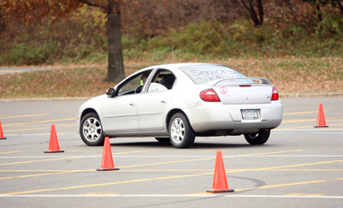
Driving while Impaired – delayed reaction time

Slide 28
Why create a formal concussion management program?
Facilitate best care for injured student
Provide a liaison between doctors, teachers, administrators and parents
Insure continued academic progress and good health while healing
Standardizing practice reduces misses

Slide 29
Preparation and awareness
Educate the school community
Coaches, administrators, nurses, and teachers
Staff should recognize alterations in normal behavior patterns, or diminished academic performance in athletes
Attempt to identify athletes at risk for more severe concussions, i.e. those with modifying factors
Consider pre-season baseline neuro-cognitive testing

Slide 30
Preparation and awareness
Monitor sports equipment
Insure staff available for injury assessment and referrals for further medical care.
Advocate for concussion and safe play.
Be aware of concussions that occurred during the school year and on vacation
Follow injured athletes as they transition between sports

Slide 31
Preparation and awareness
Postseason debriefing
Review injuries
Discuss improvements in action plan

